Slide 1

Advanced File Transfer and Data Processing System
Week 2 Update [09/04/2024]
By
Sreerag Pillai, Evan Raju, Lynette Wilson Pinto, Soundarya Anand, & Chandana Pacha

Slide 2

Hugging Face 🤗
x`
Hugging Face provides a wide range of pre-trained models that we have utilized to enhance various capabilities in our project.
Meta LLaMA
Flan T5
BERT
GPT-NeoX
Microsoft Phi 3.5 Mini
Big Science Bloom - 560m

Slide 3


Model Comparison
x`
Benchmark/Features | Microsoft Phi 3.5 Mini | Big Science Bloom - 560m
Parameter Count | 3.8 Billion | 560 Million
Specialization | Strong reasoning, especially for code, math, and logic | Multilingual text generation, including code
Context Length | 128K tokens | 2048 tokens
Latency and Resource Usage | Resource intensive, Optimized | Lower resource consumption
Risks and Limitations | Risks of generating factual outputs in small models (Fine tuning!) | Limited reasoning capacity due to smaller size
Model Documentation | https://huggingface.co/microsoft/Phi-3.5-mini-instruct | https://huggingface.co/bigscience/bloom-560m

Slide 4
Expected Computational resources
DA
Testing Environment:
Platform: Google Collab
GPU: NVIDIA T4
Execution Time Phi 3.5 Mini: ~1 min
Execution Time Bloom 560m: ~5 min
Expected Environment:
Phi Mini: Min NVIDIA T4 or High end CPU & Minimum 8GB -12GB GPU memory
BLOOM: Min NVIDIA V100 & Minimum 16GB GPU memory
Further optimization techniques:
Quantization
Pruning

Slide 5
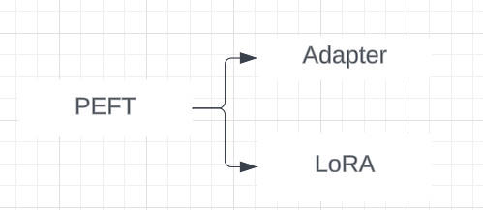
Next Milestone
Playing around with the application and create dataset
Fine tuning the model with the created dataset

Slide 6
Queries
JSON Structure: IDs, scheduleInterval, startDate, catchup, and customQuery
Multiple Sources & Destinations: Support for multiple source and destination configurations.
Metadata IDs: Fetch metadataId for source and destination; provide relevant resources for reference.
Transformations
Access to Lab

Slide 7
Questions?

Slide 8
Thank you for your time!

